Slide 1

Learn to Share and Collaborate using GITHUB
Subtitle

Slide 2
CONTENT
Version Control System
Open Source Software
Git
Github
Terminology
Git vs Github

Slide 3
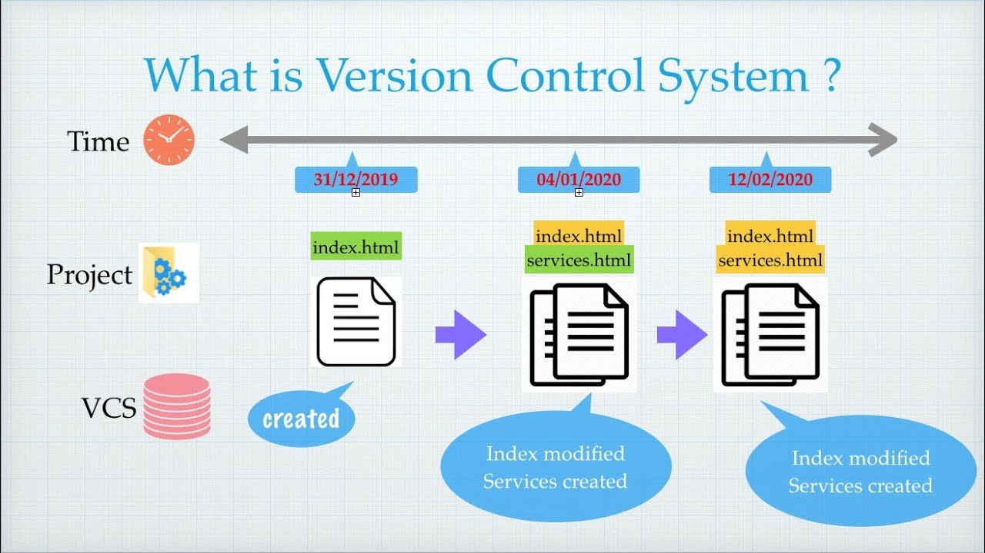
VERSION CONTROL SYSTEM(VCS)
WHAT IS A VERSION CONTROL SYSTEM ?
Version control is the practice of tracking and managing changes to software code.
Version control systems are software tools that help software teams manage changes to source code over time.

Slide 4
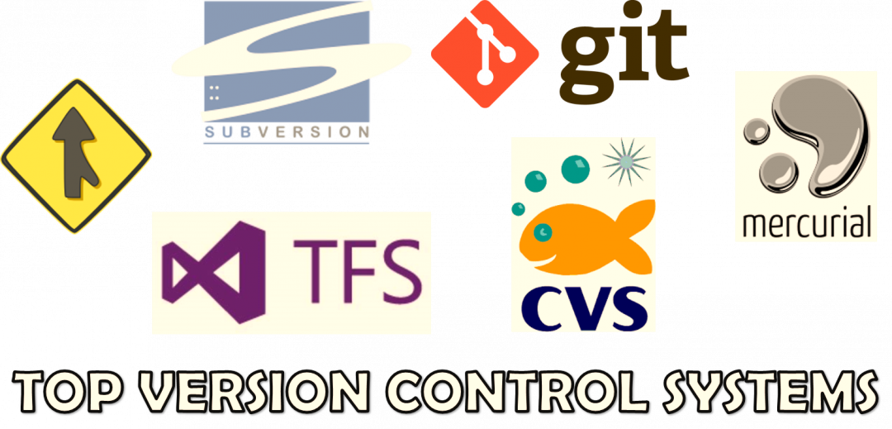
VERSION CONTROL SYSTEM(VCS)
WHY USE VERSION CONTROL ?
revert selected files back to a previous state
revert the entire project back to a previous state
compare changes over time
see who last modified something that might be causing a problem.
who introduced an issue and when.

Slide 5

WHAT IS OPEN SOURCE ?
Denotes software for which the original source code is made freely available and may be redistributed and modified.
They are highly cost effective, have a lot of resources and have abundant support available to them.
A few examples: Java, Python, MySql, Scratch, Ubuntu and Github.

Slide 6
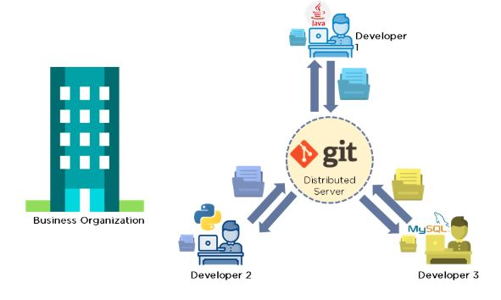
WHAT IS GIT ?
Git is a version control system used to track changes in computer files some of it most prominent features:
Tracks history
Free and open source
Supports non-linear development
Creates backups
Scalable
Supports collaboration
Branching is easier
Distributed development

Slide 7

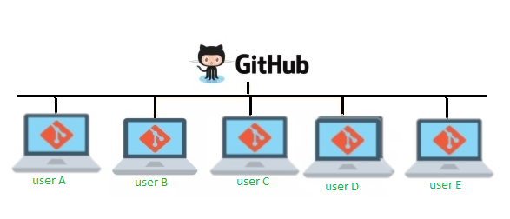
What is Github ?
GitHub is a cloud-based hosting service that lets you manage Git repositories.
Enables you to contribute to Open Source Software
Contribute code/documentation to existing projects
Sponsor Projects
Collaborative workspace for Organizations

Slide 8
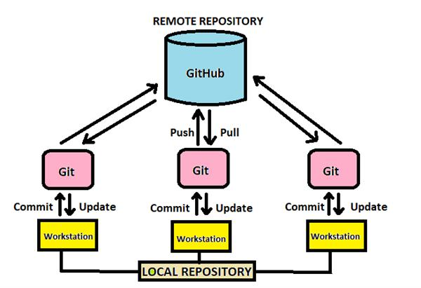
Terminologies
REPOSITORIES: These contain a collection of files of various different versions of a Project
COMMIT: The commit command will save all staged changes, along with a brief description from the user.
PULL REQUEST: When you are asking to submit your work(in patches) to the owner of repo.

Slide 9
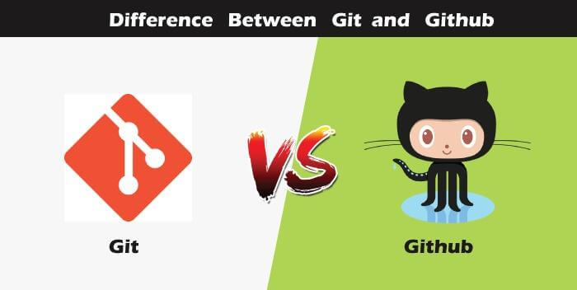
GIT V/S GITHUB
GIT
GITHUB
Git is a software.
Git is a command-line tool.
Git is maintained by linux.
Git is focused mainly on the version control and code sharing.
Git is installed locally on the system.
Github is a service.
Github is a Graphical User interface.
Github is maintained by Microsoft.
Github is focused on central source code hosting.
Git is hosted on the web.

Slide 10
THANK YOU
ANY QUESTIONS OR QUERIES ?

